Slide 1
Human-Caused Global Warming
Norton Pengra, Nicholas Sutanto, Jessica Mejia, Brenda Herman

Slide 2
Defining the Problem
Notes:
So what does “Human Caused Climate Change” mean anyways?

Slide 3

Definition for global warming - what is global warming? The question about the definition for global warming or in other words "what is global warming" is relatively easy to answer. We hereby lean at the definitions and explanations given in Wikipedia: Global warming is the observed and projected increases in the average temperature of Earth's atmosphere and oceans. The Earth's average temperature rose about 0.6° Celsius (1.1° Fahrenheit) in the 20th …

Slide 4
Definition for global warming - what is global warming? The question about the definition for global warming or in other words "what is global warming" is relatively easy to answer. We hereby lean at the definitions and explanations given in Wikipedia: Global warming is the observed and projected increases in the average temperature of Earth's atmosphere and oceans. The Earth's average temperature rose about 0.6° Celsius (1.1° Fahrenheit) in the 20th …

Slide 5
Definition for global warming - what is global warming? The question about the definition for global warming or in other words "what is global warming" is relatively easy to answer. We hereby lean at the definitions and explanations given in Wikipedia: Global warming is the observed and projected increases in the average temperature of Earth's atmosphere and oceans. The Earth's average temperature rose about 0.6° Celsius (1.1° Fahrenheit) in the 20th …

Slide 6

An increase in the average temperature of the Earth's atmosphere, especially a sustained increase great enough to cause changes in the global climate. The Earth has experienced numerous episodes of global warming through its history, and currently appears to be undergoing such warming. The present warming is generally attributed to an increase in the greenhouse effect, brought about by increased levels of greenhouse gases, largely due to the effects of human industry and agriculture. Expected long-term effects of current global warming are rising sea levels, flooding, melting of polar ice caps and glaciers, fluctuations in temperature and precipitation, more frequent and stronger El Niños and La Niñas, drought, heat waves, and forest fires.

Slide 7
An increase in the average temperature of the Earth's atmosphere, especially a sustained increase great enough to cause changes in the global climate. The Earth has experienced numerous episodes of global warming through its history, and currently appears to be undergoing such warming. The present warming is generally attributed to an increase in the greenhouse effect, brought about by increased levels of greenhouse gases, largely due to the effects of human industry and agriculture. Expected long-term effects of current global warming are rising sea levels, flooding, melting of polar ice caps and glaciers, fluctuations in temperature and precipitation, more frequent and stronger El Niños and La Niñas, drought, heat waves, and forest fires.

Slide 8
An increase in the average temperature of the Earth's atmosphere, especially a sustained increase great enough to cause changes in the global climate. The Earth has experienced numerous episodes of global warming through its history, and currently appears to be undergoing such warming. The present warming is generally attributed to an increase in the greenhouse effect, brought about by increased levels of greenhouse gases, largely due to the effects of human industry and agriculture. Expected long-term effects of current global warming are rising sea levels, flooding, melting of polar ice caps and glaciers, fluctuations in temperature and precipitation, more frequent and stronger El Niños and La Niñas, drought, heat waves, and forest fires.

Slide 9

Climate change is any substantial change in Earth’s climate that lasts for an extended period of time. Global warming refers to climate change that causes an increase in the average temperature of the lower atmosphere. Global warming can have many different causes, but it is most commonly associated with human interference, specifically the release of excessive amounts of greenhouse gases.

Slide 10

Climate change is any substantial change in Earth’s climate that lasts for an extended period of time. Global warming refers to climate change that causes an increase in the average temperature of the lower atmosphere. Global warming can have many different causes, but it is most commonly associated with human interference, specifically the release of excessive amounts of greenhouse gases.

Slide 11
Climate change is any substantial change in Earth’s climate that lasts for an extended period of time. Global warming refers to climate change that causes an increase in the average temperature of the lower atmosphere. Global warming can have many different causes, but it is most commonly associated with human interference, specifically the release of excessive amounts of greenhouse gases.

Slide 12
Climate change is any substantial change in Earth’s climate that lasts for an extended period of time. Global warming refers to climate change that causes an increase in the average temperature of the lower atmosphere. Global warming can have many different causes, but it is most commonly associated with human interference, specifically the release of excessive amounts of greenhouse gases.

Slide 13
Defining the Problem
Notes:
So what does “Human Caused Climate Change” mean anyways?

Slide 14
Climate change is any substantial change in Earth’s climate that lasts for an extended period of time. Global warming refers to climate change that causes an increase in the average temperature of the lower atmosphere. Global warming can have many different causes, but it is most commonly associated with human interference, specifically the release of excessive amounts of greenhouse gases.

Slide 15



Climate change is any substantial change in Earth’s climate that lasts for an extended period of time. Global warming refers to climate change that causes an increase in the average temperature of the lower atmosphere. Global warming can have many different causes, but it is most commonly associated with human interference, specifically the release of excessive amounts of greenhouse gases.

Slide 16
Climate change is any substantial change in Earth’s climate that lasts for an extended period of time. Global warming refers to climate change that causes an increase in the average temperature of the lower atmosphere. Global warming can have many different causes, but it is most commonly associated with human interference, specifically the release of excessive amounts of greenhouse gases.

Slide 17


“Climate change is a long-term shift in the statistics of the weather (including its averages). For example,
it could show up as a change in climate normals
(expected average values for temperature and
precipitation) for a given place and time of year,
from one decade to the next.”
“Climate change refers to any significant change in the measures of climate lasting for an extended period of time. In other words, climate change includes major changes in temperature, precipitation, or wind patterns, among other effects, that occur over several decades or longer.”

Slide 18
“Climate change is a long-term shift in the statistics of the weather (including its averages). For example,
it could show up as a change in climate normals
(expected average values for temperature and
precipitation) for a given place and time of year,
from one decade to the next.”
“Climate change refers to any significant change in the measures of climate lasting for an extended period of time. In other words, climate change includes major changes in temperature, precipitation, or wind patterns, among other effects, that occur over several decades or longer.”

Slide 19
Climate change is any substantial change in Earth’s climate that lasts for an extended period of time. Global warming refers to climate change that causes an increase in the average temperature of the lower atmosphere. Global warming can have many different causes, but it is most commonly associated with human interference, specifically the release of excessive amounts of greenhouse gases.

Slide 20
Climate change is any substantial change in Earth’s climate that lasts for an extended period of time. Global warming refers to climate change that causes an increase in the average temperature of the lower atmosphere. Global warming can have many different causes, but it is most commonly associated with human interference, specifically the release of excessive amounts of greenhouse gases.

Slide 21
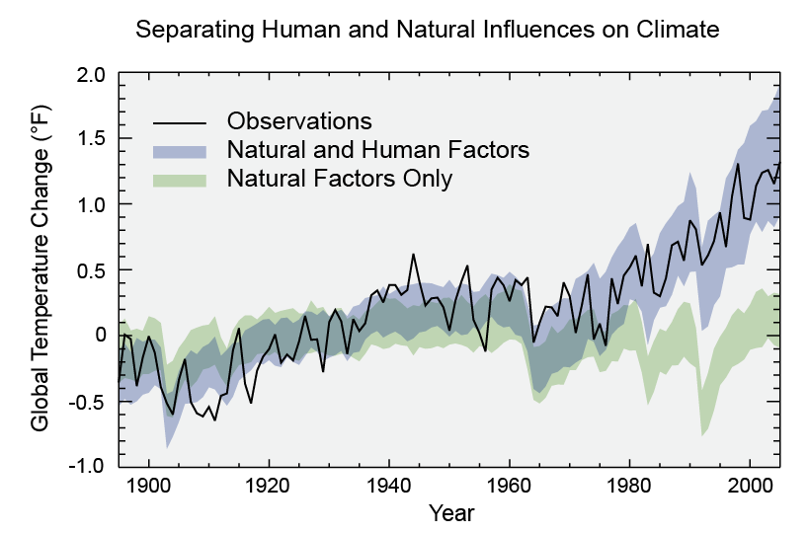
Climate change is any substantial change in Earth’s climate that lasts for an extended period of time. Global warming refers to climate change that causes an increase in the average temperature of the lower atmosphere. Global warming can have many different causes, but it is most commonly associated with human interference, specifically the release of excessive amounts of greenhouse gases.
“Human Caused”
due to human activities.

Slide 22
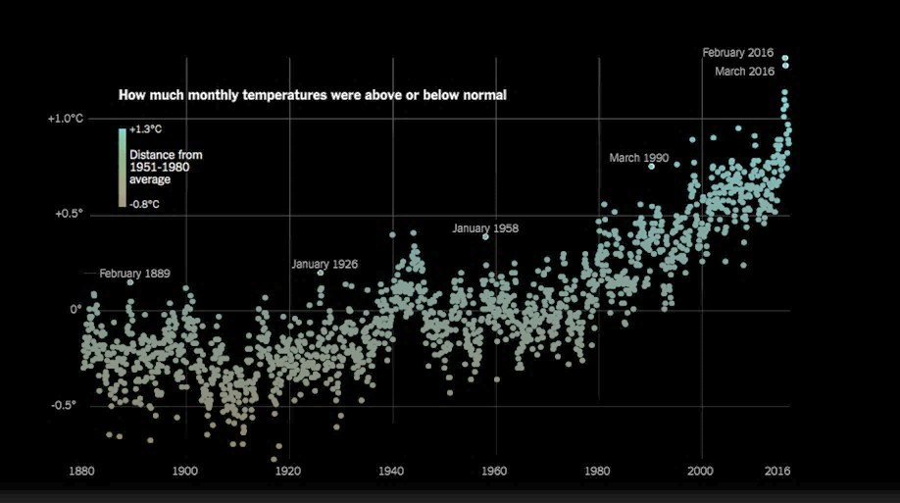



Slide 23

“Global temperature records start around 1880 because observations did not sufficiently cover enough of the planet prior to that time. The period of 1951-1980 was chosen largely because the U.S. National Weather Service uses a three-decade period to define “normal” or average temperature. The GISS temperature analysis effort began around 1980, so the most recent 30 years was 1951-1980. It is also a period when many of today’s adults grew up, so it is a common reference that many people can remember.”

Slide 24
“Global temperature records start around 1880 because observations did not sufficiently cover enough of the planet prior to that time. The period of 1951-1980 was chosen largely because the U.S. National Weather Service uses a three-decade period to define “normal” or average temperature. The GISS temperature analysis effort began around 1980, so the most recent 30 years was 1951-1980. It is also a period when many of today’s adults grew up, so it is a common reference that many people can remember.”

Slide 25
“Global temperature records start around 1880 because observations did not sufficiently cover enough of the planet prior to that time. The period of 1951-1980 was chosen largely because the U.S. National Weather Service uses a three-decade period to define “normal” or average temperature. The GISS temperature analysis effort began around 1980, so the most recent 30 years was 1951-1980. It is also a period when many of today’s adults grew up, so it is a common reference that many people can remember.”

Slide 31
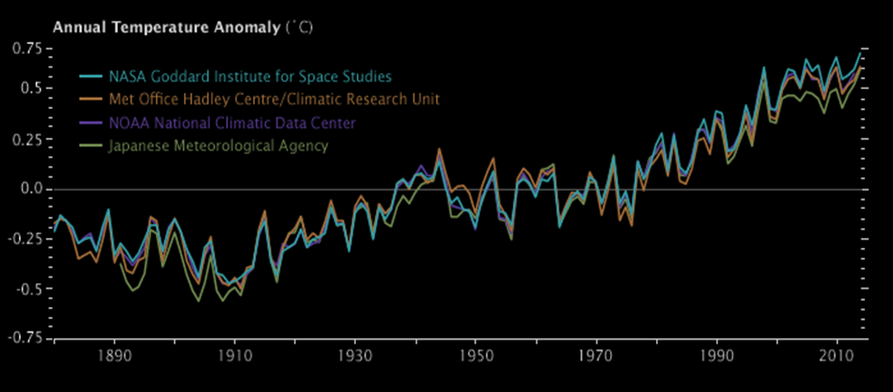

Slide 32
Convection
Dynamics
Radiation
Zhang-McFarlane
Emanuel
Emanuel hard adjustment
Simplified Betts-Miller
Axisymmetric Dynamics
Two column Dynamics
Community Atmosphere Model 3
CCM 3
Chou
Grey Gas
Rapid Radiative Transfer Model
Insolation
Absorption by ozone
Turbulence
CCM3
Simple
Other Factors
Thermodynamics
Ocean Model

Slide 33
Convection
Dynamics
Radiation
Zhang-McFarlane
Emanuel
Emanuel hard adjustment
Simplified Betts-Miller
Axisymmetric Dynamics
Two column Dynamics
Community Atmosphere Model 3
CCM 3
Chou
Grey Gas
Rapid Radiative Transfer Model
Insolation
Absorption by ozone
Turbulence
CCM3
Simple
Other Factors
Thermodynamics
Ocean Model

Slide 34



Convection
Dynamics
Radiation
Zhang-McFarlane
Emanuel
Emanuel hard adjustment
Simplified Betts-Miller
Axisymmetric Dynamics
Two column Dynamics
Community Atmosphere Model 3
CCM 3
Chou
Grey Gas
Rapid Radiative Transfer Model
Insolation
Absorption by ozone
Turbulence
CCM3
Simple
Other Factors
Thermodynamics
Ocean Model

Slide 35









bcc-csm1-1
HadGEM2-ES
inmcm4
CanESM2
IPSL-CM5A-LR
CESM1-BGC
MIROC-ESM∗
MPI-ESM-LR
GFDL-ESM2G

Slide 36
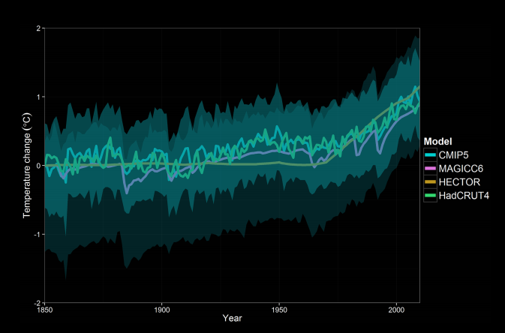

Slide 37
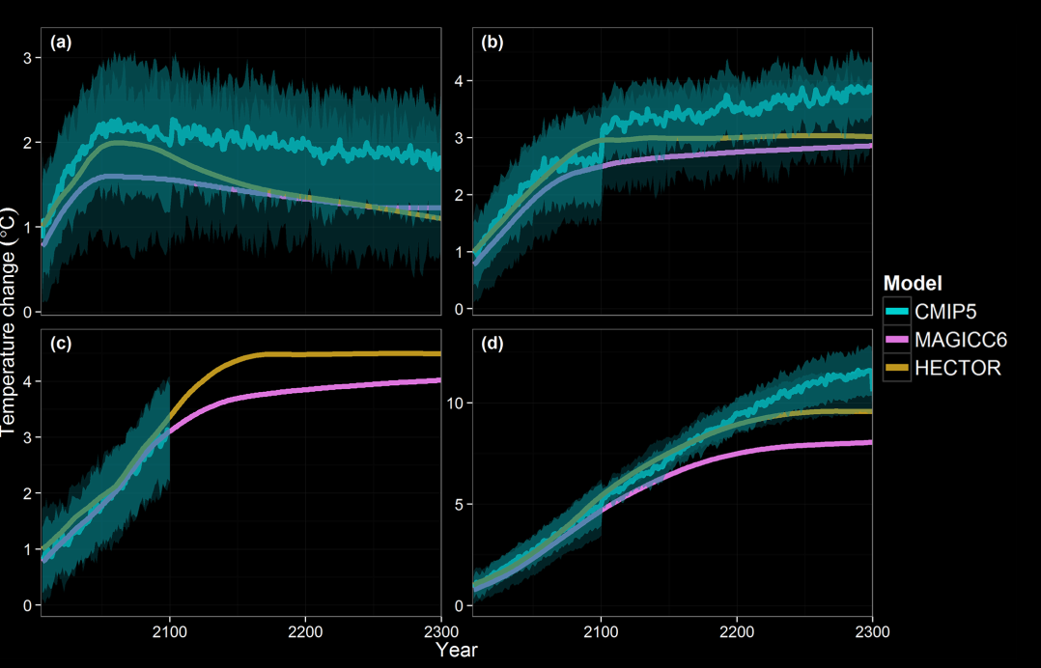

Slide 38
R C P

Slide 39
R.C.P.
(Representative Concentration Pathways)

Slide 40
R.C.P.
(Representative Concentration Pathways)
((commonly associated w/ ECP))

Slide 41
R.C.P.
(Representative Concentration Pathways)
((commonly associated w/ ECP))
(((Extended Concentration Pathways)))

Slide 43
RCP2.6
RCP4.5
RCP6.0
RCP8.5

Slide 44
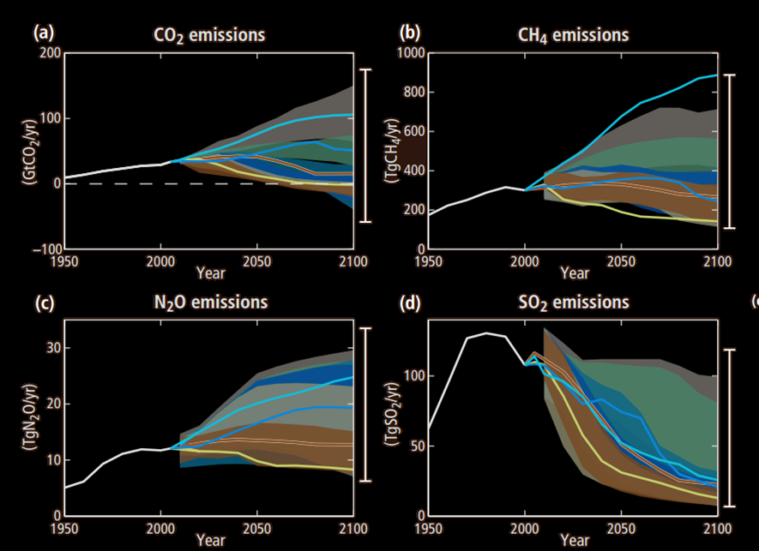

Slide 45
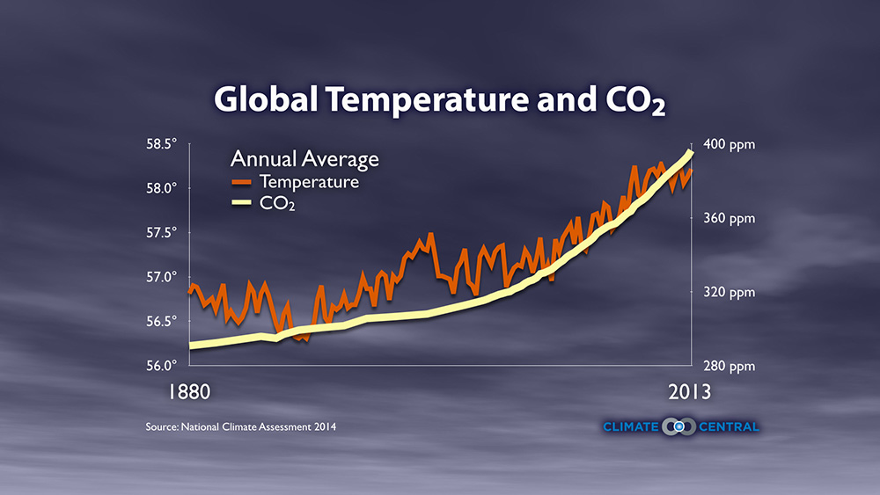

Slide 46
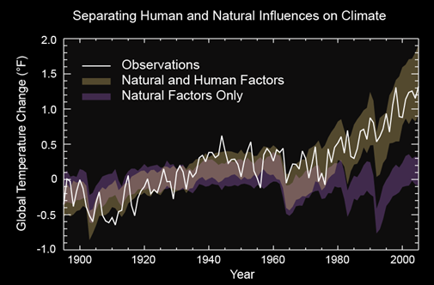

Slide 48

0.000001% of 7 Billion

Slide 51
532,333.37 Metric Tons CO2

Slide 52
(per breath)
532,333.37 Metric Tons CO2

Slide 53
(per minute)
532,333.37 Metric Tons CO2
9,049,661 Metric Tons CO2

Slide 54
(per hour)
532,333.37 Metric Tons CO2
9,049,661 Metric Tons CO2
542,979,660 Metric Tons CO2

Slide 55
(per day)
532,333.37 Metric Tons CO2
9,049,661 Metric Tons CO2
542,979,660 Metric Tons CO2
13,031,511,840 Metric Tons CO2

Slide 56
(per day)
532,333.37 Metric Tons CO2
9,049,661 Metric Tons CO2
542,979,660 Metric Tons CO2
>13,031,511,840 Metric Tons CO2

Slide 58
RCP2.6
RCP4.5
RCP6.0
RCP8.5

Slide 59
Climate change is any substantial change in Earth’s climate that lasts for an extended period of time. Global warming refers to climate change that causes an increase in the average temperature of the lower atmosphere. Global warming can have many different causes, but it is most commonly associated with human interference, specifically the release of excessive amounts of greenhouse gases.

Slide 60
Climate change is any substantial change in Earth’s climate that lasts for an extended period of time. Global warming refers to climate change that causes an increase in the average temperature of the lower atmosphere. Global warming can have many different causes, but it is most commonly associated with human interference, specifically the release of excessive amounts of greenhouse gases.
“Human Caused”
due to human activities.

Slide 61

“This modelling method has been used particularly for malaria and dengue fever. The malaria modelling shows that small temperature increases can greatly affect transmission potential. Globally, temperature increases of 2-3ºC would increase the number of people who, in climatic terms, are at risk of malaria by around 3- 5%, i.e. several hundred million. Further, the seasonal duration of malaria would increase in many currently endemic areas.”

Slide 62

“This modelling method has been used particularly for malaria and dengue fever. The malaria modelling shows that small temperature increases can greatly affect transmission potential. Globally, temperature increases of 2-3ºC would increase the number of people who, in climatic terms, are at risk of malaria by around 3- 5%, i.e. several hundred million. Further, the seasonal duration of malaria would increase in many currently endemic areas.”

Slide 63
“This modelling method has been used particularly for malaria and dengue fever. The malaria modelling shows that small temperature increases can greatly affect transmission potential. Globally, temperature increases of 2-3ºC would increase the number of people who, in climatic terms, are at risk of malaria by around 3- 5%, i.e. several hundred million. Further, the seasonal duration of malaria would increase in many currently endemic areas.”

Slide 64
*OH + CO → *HOCO
*HOCO + O2 → HO2* + CO2
HO2* + NO → *OH + NO2
NO2 + hv → NO + O( P)
3
O( P) + O2 → O3
3

Slide 65
“In particular, exposure to pollutants such as particulate matter and ozone has been found to be associated with increases in hospital admissions for cardiovascular and respiratory disease and mortality in many cities in Europe and other continents”

Slide 66

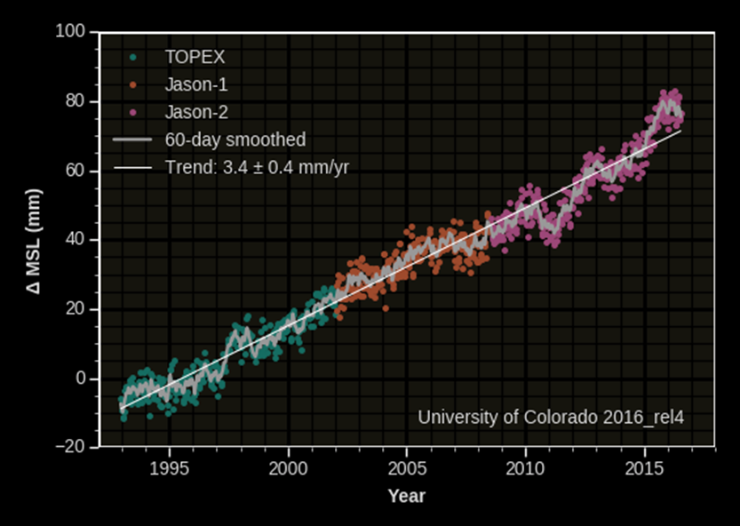

Slide 67

“Climate change is already contributing to the deaths of nearly 400,000 people a year and costing the world more than $1.2 trillion, wiping 1.6% annually from global GDP, according to a new study.”
“By 2030, the researchers estimate, the cost of climate change and air pollution combined will rise to 3.2% of global GDP, with the world's least developed countries forecast to bear the brunt, suffering losses of up to 11% of their GDP.”

Slide 68
“Climate change is already contributing to the deaths of nearly 400,000 people a year and costing the world more than $1.2 trillion, wiping 1.6% annually from global GDP, according to a new study.”
“By 2030, the researchers estimate, the cost of climate change and air pollution combined will rise to 3.2% of global GDP, with the world's least developed countries forecast to bear the brunt, suffering losses of up to 11% of their GDP.”

Slide 69
“Climate change is already contributing to the deaths of nearly 400,000 people a year and costing the world more than $1.2 trillion, wiping 1.6% annually from global GDP, according to a new study.”
“By 2030, the researchers estimate, the cost of climate change and air pollution combined will rise to 3.2% of global GDP, with the world's least developed countries forecast to bear the brunt, suffering losses of up to 11% of their GDP.”

Slide 70
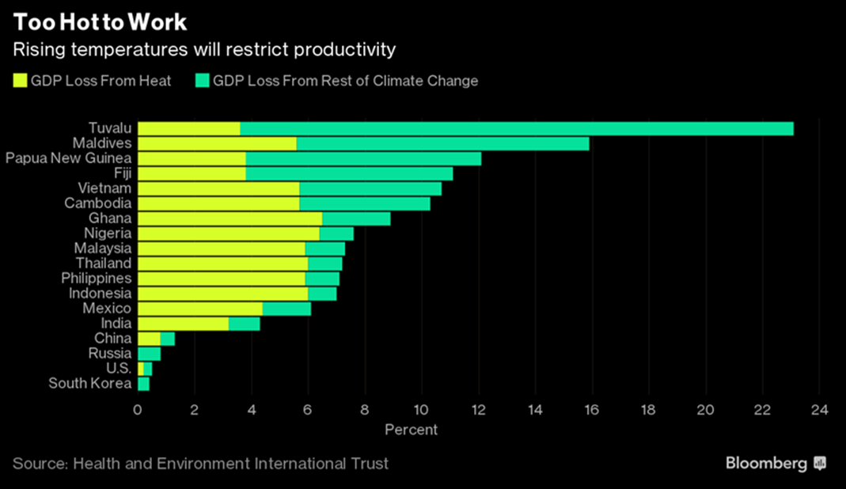

Slide 71


Renewable energy jobs are growing

Slide 72
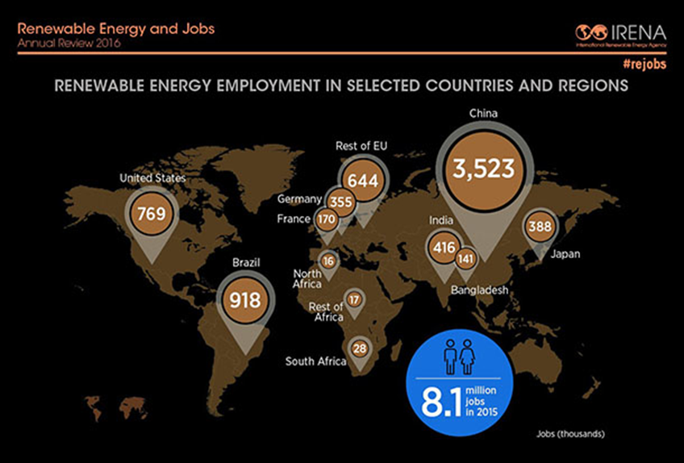

Slide 73
RCP2.6
RCP4.5
RCP6.0
RCP8.5

Slide 74
Climate change is any substantial change in Earth’s climate that lasts for an extended period of time. Global warming refers to climate change that causes an increase in the average temperature of the lower atmosphere. Global warming can have many different causes, but it is most commonly associated with human interference, specifically the release of excessive amounts of greenhouse gases.
“Human Caused”
due to human activities.

